Slide 1

Predictive Maintenance Analysis
Ahmed Nasser

Slide 2
Table of Contents
Introduction
Preprocessing
Model
Dataset Overview
Data Exploration
Important Features
ROC Analysis

Slide 3


1. Introduction
The project aimed to predict machine failures without knowing the specific failure mode. With a dataset comprising 10,000 rows and 14 columns, the focus was on key features such as Air Temperature, Process Temperature, Rotational Speed, Torque, and Tool Wear.
The objective was to develop models that accurately predict machine failures based on these features.

Slide 4
2. Dataset Overview
Data Points:
Process Temperature [K]
Rotational Speed [rpm]
Torque [Nm]
Tool Wear [min]
10,000 rows
Air Temperature [K]
Failure Labels: [1 Failure | 0 No Failure]

Slide 5

3. Data Exploration
Checked null values by using isnull().sum() function to calculate the null values on each column
Check for duplicates across all cloumns by using .duplicated()
Identified key variables such an Air Temperature [K],Process Temperature [K], Rotational Speed [rpm],Torque [Nm] And Tool Wear [min] as primary areas of interest for analysis.

Slide 6
4. Preprocessing
Delete null values
Handle Categorical Variables
Feature Engineering

Slide 7

5. Model
Models were chosen based on each model’s suitability for binary classification tasks and their ability to handle complex relationships.
Model | Accuracy
XG-Boost | 99.0 %
Random Forest | 98.4 %
SVM | 97.0 %

Slide 8
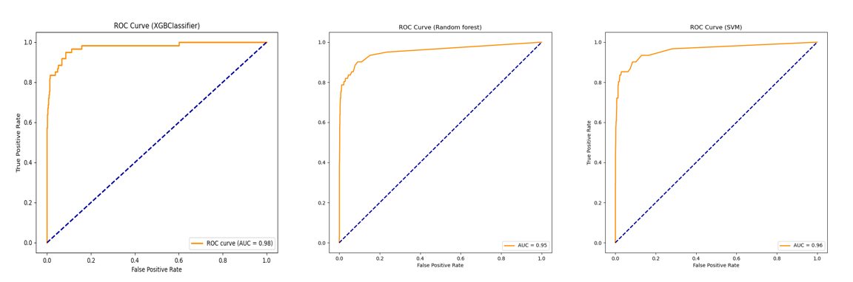
6. ROC Analysis

Slide 9

7. Important Features
Torque (Nm): 19.02%
Air Temperature (K): 17.35%
Process Temperature (K): 14.99%
Tool Wear (min): 13.36%
Rotational Speed (rpm): 12.66%
Type_L: 12.06%
Type_M: 4.47%
A comparative analysis was conducted to assess the performance of the XG-Boost, Random Forest and SVM models.
Insights into feature importance were derived to understand factors contributing to machine failures.

Slide 10




Thank You

